Slide 1


CEF440:INTERNET AND MOBILE PROGRAMMING
PROJECT:
Biometric Student Attendance
Presented by: Group 19
TASK 3:
Requirement analysis
Instructor: Dr NKEMENI VALERY

Slide 2
CONTENT
01
Introduction and definition
.
02
Purpose of requirement analysis
03
Methods to analyze requirements
04
Activities involved
05
Potential risk/conflicts in the requirements
06
Conclusion

Slide 3
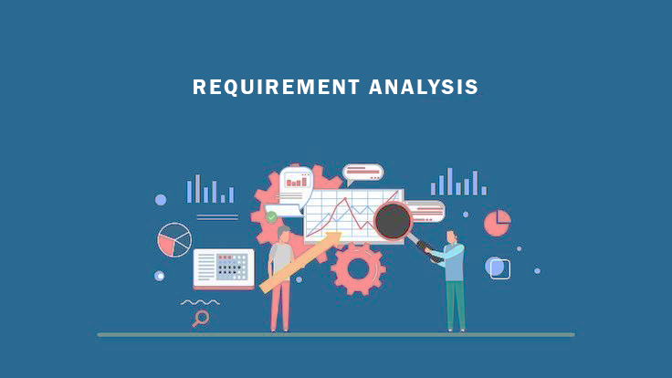
1. INTRODUCTION AND DEFINITION
INTRODUCTION
In the contemporary educational landscape, the efficient tracking of student attendance stands as a pivotal aspect of institutional management
DEFINITION
Requirement analysis of a biometric student attendance system involves the systematic process of gathering, documenting, analyzing, and defining the specific needs, objectives, functionalities, and constraints of developing a mobile application
What is this all about

Slide 4

2. PURPOSE OF REQUIREMENT ANALYSIS
It is not a wastage of time. I analyze them to achieve the following
Understanding of Stakeholder Needs
Project Scope Definition
Requirements Identification
Risk minimization
Guidance in Design and Development
Why do you even waste your time analyzing these requirements

Slide 5

3. METHODS TO ANALYZE REQUIREMENTS
Research:
We made research on existing systems or projects to come out with some functional and non-functional requirements of a biometric student attendance application
Workshops:
Here we had meeting sessions with the group members to analyze the requirements gathered from the various stakeholders gotten through interviews, surveys and questionnaires.

Slide 6
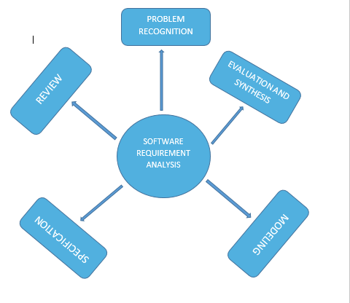
4.0 ACTIVITIES INVOLVED

Slide 7

4.1 PROBLEM RECOGNITION
Purpose:
Problem recognition has to do with fully understanding the main objective of requirement, including why it is needed, does it add value, will it be beneficial, and does it have side effects
No matter what it takes I need to understand what this problem is about

Slide 8

4.2 EVALUATION AND SYNTHESIS
Evaluation
This involves assessing the gathered requirements to determine their quality, completeness, consistency, and feasibility
Synthesis
Once the requirements have been evaluated, synthesis involves combining and organizing them into a cohesive and comprehensive set

Slide 9

4.3 MODELING
Modeling
After complete analyzing of the gathered requirements and structuring them into functional, non-functional requirements, behavioral models and unified modelling language diagrams usually known as UML diagrams are established

Slide 10

4.4 SPECIFIACTION(1/3)
Product Perspective
The system is a standalone application designed to facilitate the automated tracking of student attendance using biometric identifiers
Product Functions
Enrollment
Attendance Recording
Real-Time Monitoring
Data Management
Constraint: No budget, and little time allocated,
Assumptions: Assumes that all users have fingers,
Dependencies: Relies on the availability of biometric hardware and software components
User Characteristics
Students: Users who enroll their biometric data
Teachers: Users who monitor
Administrators: oversee the system's operation
OVERALL DESCRIPTION

Slide 11
4.4 SPECIFIACTION(2/3)
Student and instructor Functional requirements:
User Registration and Profile Management
Attendance Tracking
View Attendance Records
Student Functional requirements(Admin and instructor):
User Management
System Configuration
Attendance Reporting and Analytics
System Maintenance and Support
Hardware requirements:
Mobile Devices
Biometric Sensors
Network Connectivity
Battery Life
Non-functional requirements:
Performance
Reliability
Security
Usability
Scalability
Compatibility
REQUIREMENTS

Slide 12
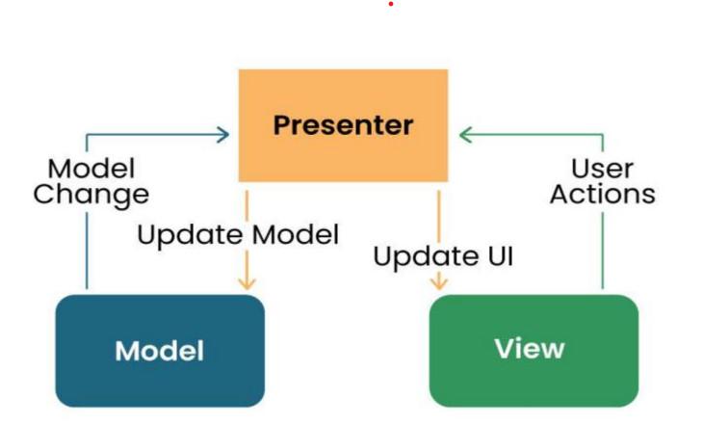

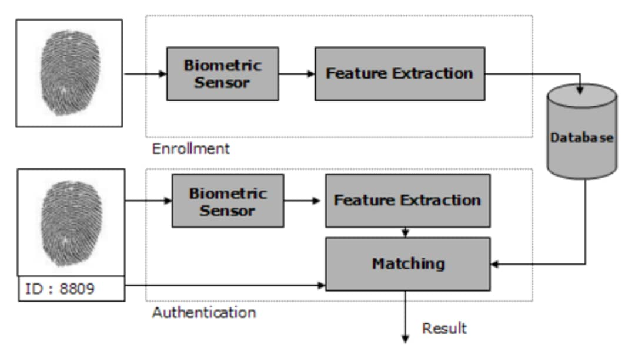
4.4 SPECIFIACTION(3/3)
Architecture Used:
For our Biometric student attendance mobile application, from the various architectures presented during the first task the architecture to be used is the MODEL VIEW PRESENTER ARCHITECTURE (MVP)

Slide 13

5.0 POTENTIAL RISK/CONFLICTS
I will like to record attendance using fingerprint
In my village my parents told me to never give my finger for any record
Some conflicts:
Privacy Concerns
Data Security
Regulatory Compliance
Cultural Sensitivities
Admin
Student

Slide 14
In conclusion, the requirement analysis of a biometric student attendance system is a multifaceted endeavor that plays a pivotal role in shaping the success of the project
6 CONCLUSION

Slide 15

6 CONCLUSION
GOOD
BYE

